Slide 1

Random Forest

Slide 2
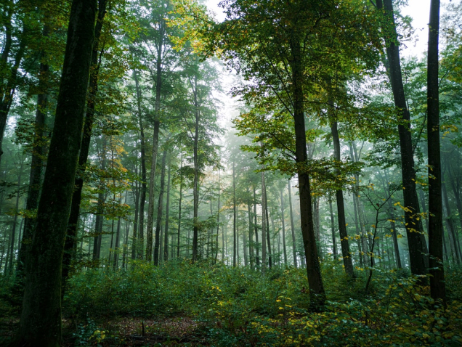
What do we do today?
Review on the Decision Tree
key concepts of Random Forest (RF)
Implement RF from scratch
Some Exercises

Slide 3
Making ensemble/collection of decision trees
idx | F1 | F2 | F3 | y
1 | 4.5 | 3.2 | 4.2 | 0
2 | 1. | 3,6 | 2.7 | 1
3 | 4.3 | 3.8 | 3.9 | 1
4 | 2.4 | 3.3 | 1.9 | 1
5 | 2. | 3. | 4. | 0
6 | 3.1 | 4.2 | 3.5 | 1
idx
2
2
4
1
6
3
idx
1
6
2
5
5
5
idx
6
1
4
1
1
2
Bootstrapping
F2, F1
F3, F2
F1,F3

Slide 4
Hyper-parameters
Number of trees
Number of levels/depth
Criterion (Gini index)

